Slide 1

A Matter of Time
Why the Age of Creation
is Foundational

Slide 2
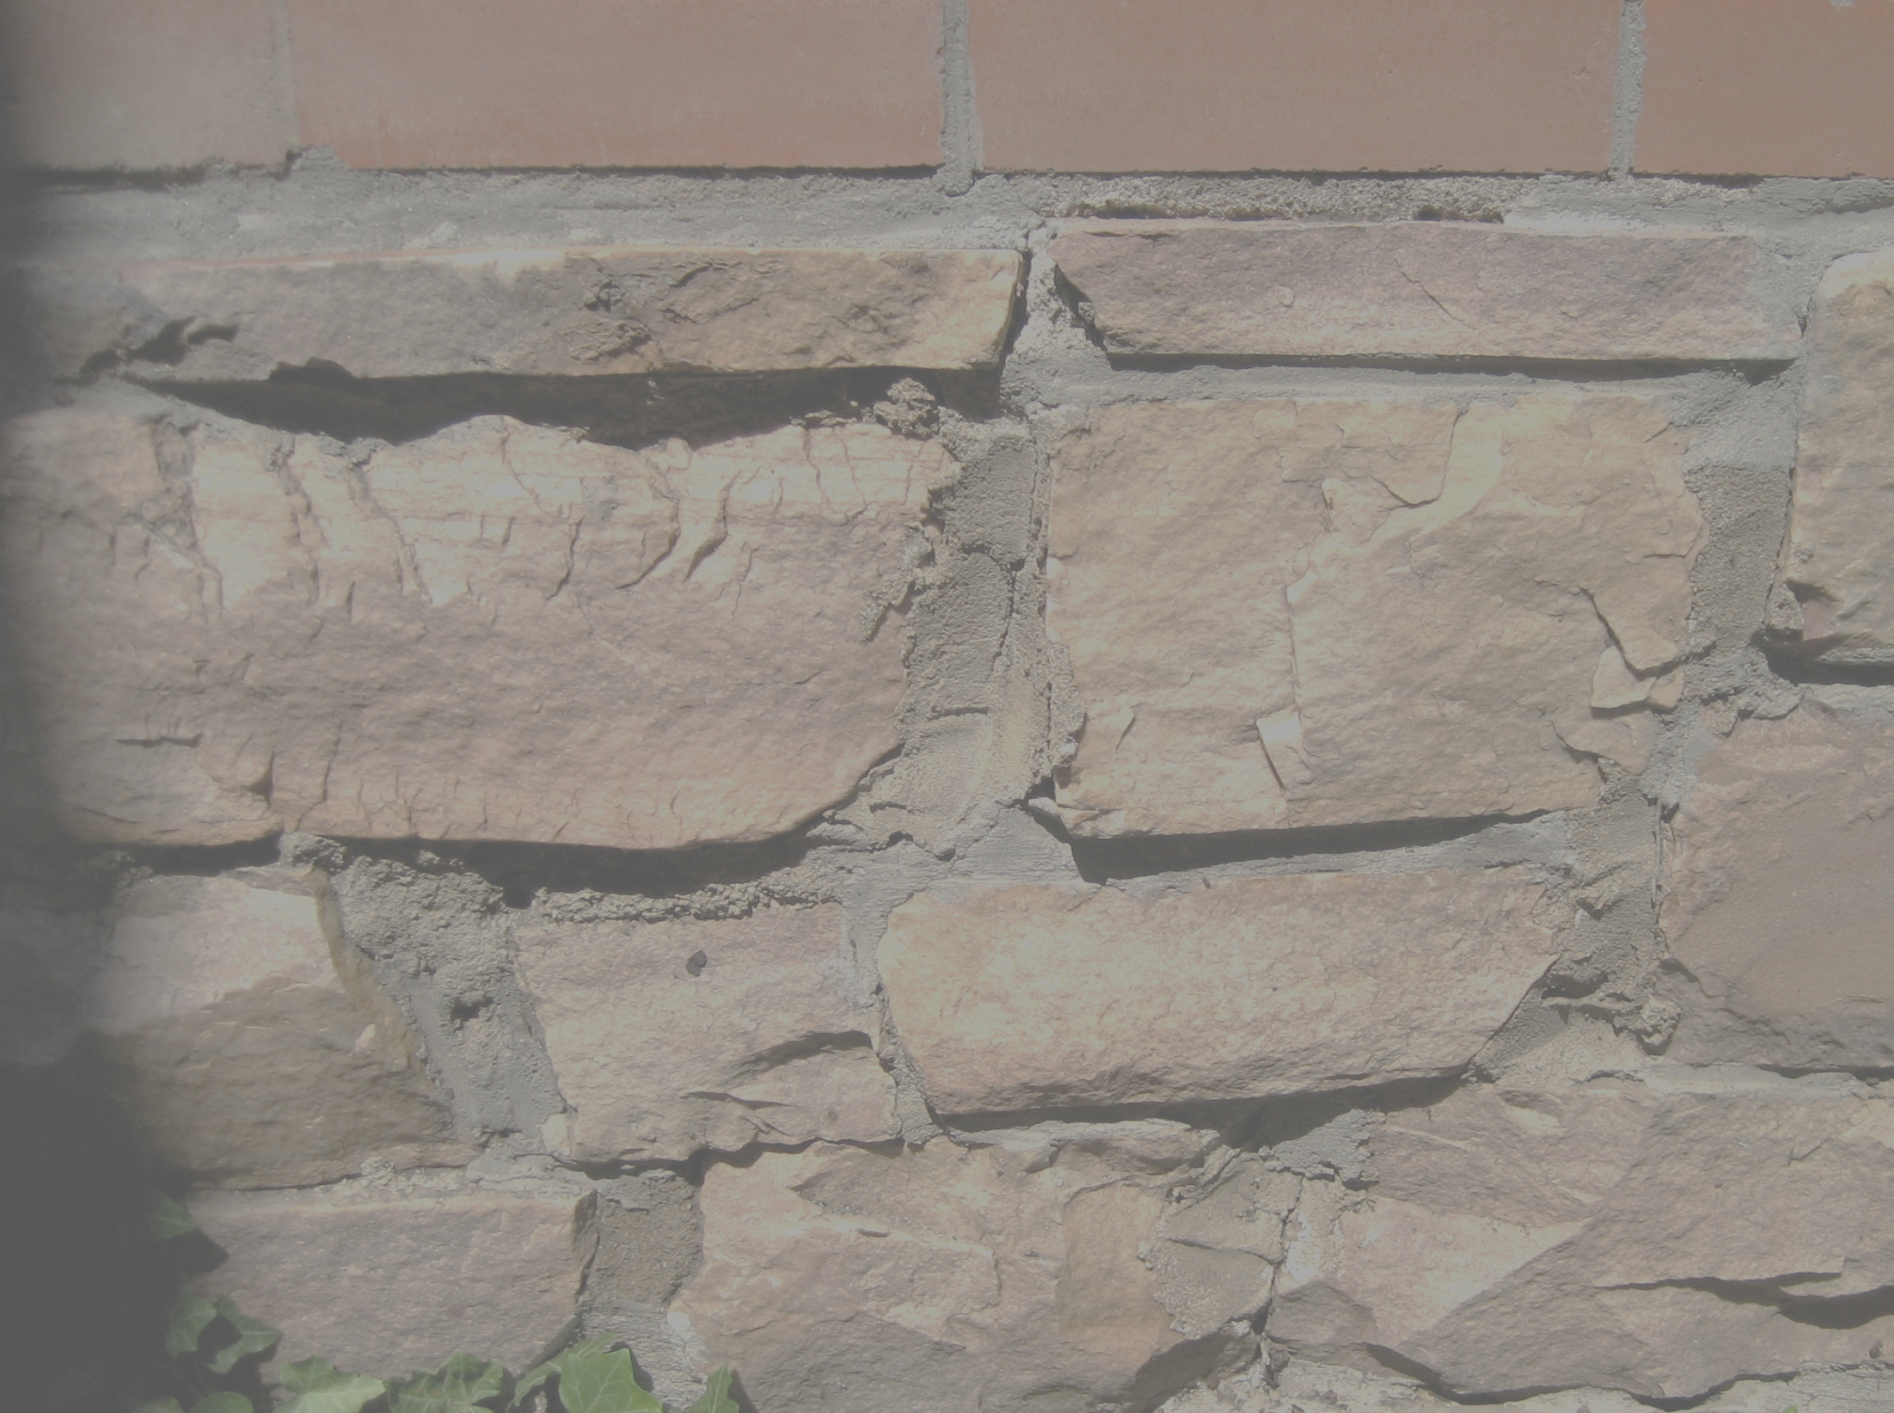
“One generation shall praise your works to another,
And shall declare your
mighty acts.”
- Psalm 145:4

Slide 3
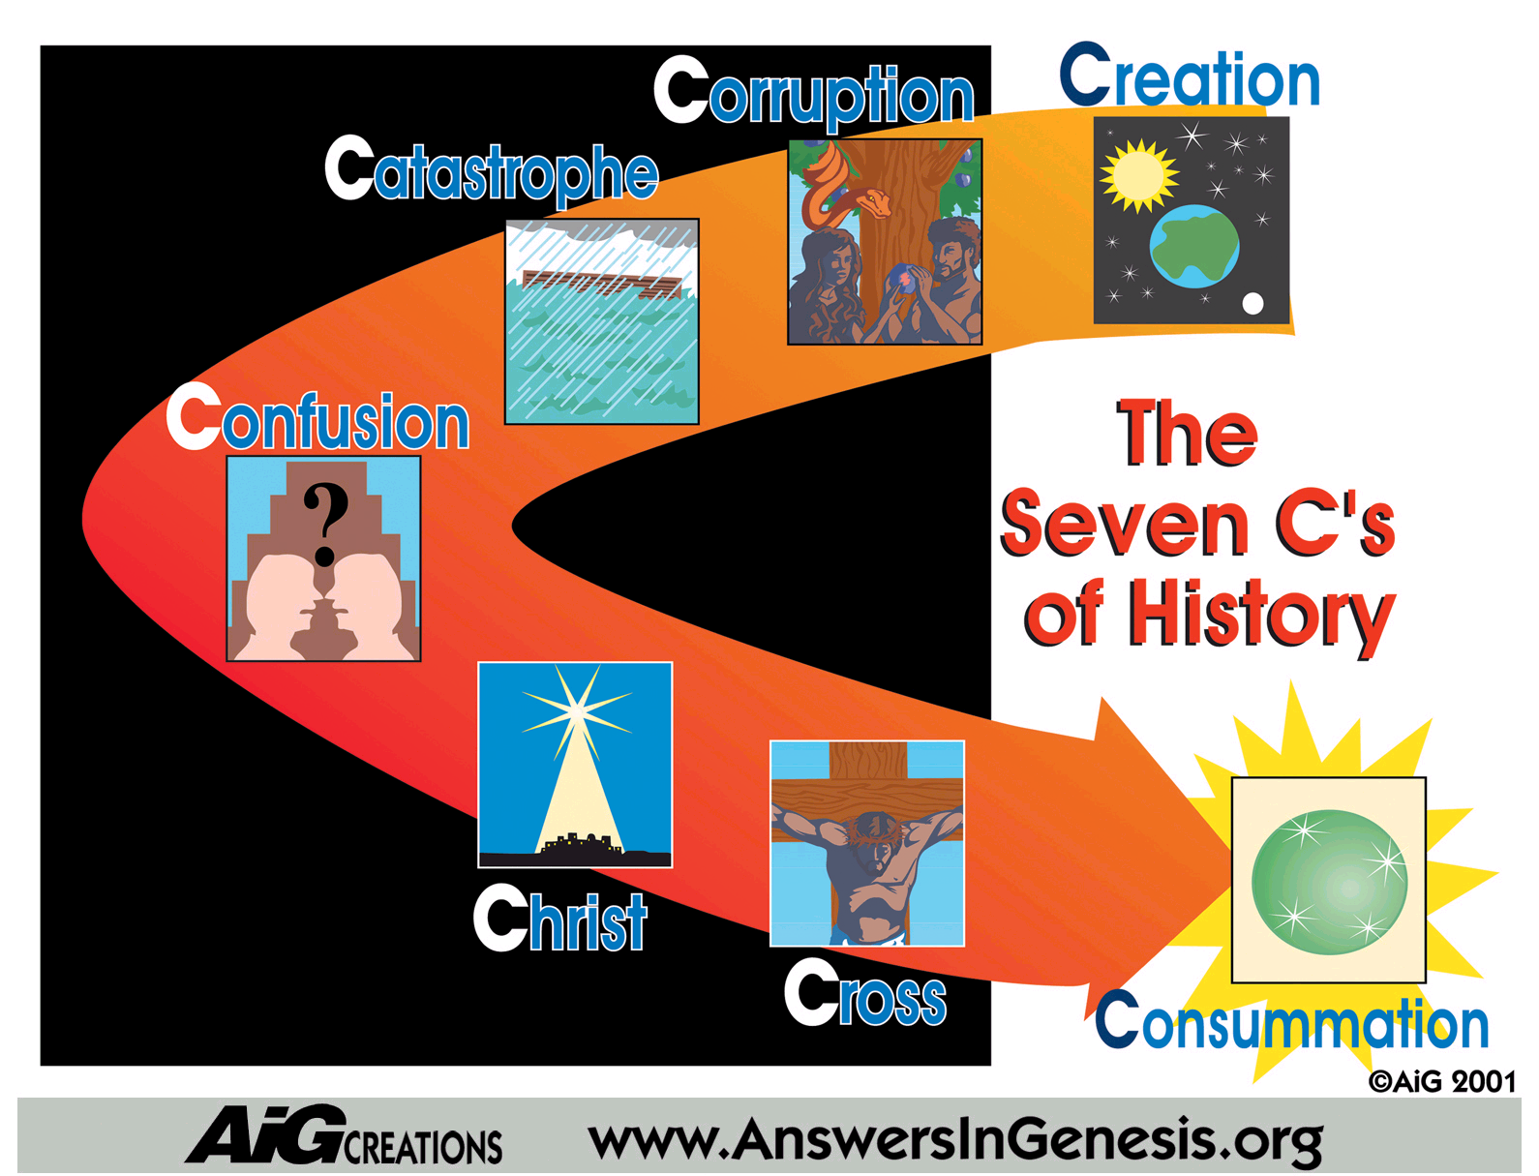







Slide 4
Those out to destroy trust in God’s Word will give up on anything except… an ancient age of the earth.
Millions of years form the very core of…
evolutionism
naturalism
atheism

Slide 5
What does the Bible say about the age of the Earth?

Slide 6

What does the Bible say about the age of the Earth?
“ And God saw everything that he had made, and, behold, it was very good. And the evening and the morning were the sixth day.”
- Genesis 1:31

Slide 7
What does the Bible say about the age of the Earth?
“ For in six days the Lord made heaven and earth, the sea and all that in them is, and rested on the seventh day…"
- Exodus 20:11
And He answered and said unto them, “Have you not read, that He which made them at the beginning made them male and female…”
- Matthew 19:4

Slide 8
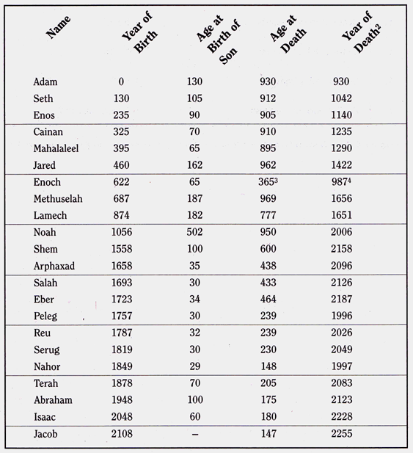
What does the Bible say about the age of the Earth?
“ This is the book of the generations of Adam. In the day that God created man, in the likeness of God made he him; male and female he made them…and Adam lived 130 years and begat a son…”
- Genesis 5:1-32

Slide 9
What does the Bible say about the age of the Earth?
“In six days the Lord made heaven and earth, the sea and all that is in them, and rested the seventh day."
- Exodus 20:11

Slide 10
What does the world say about the age of the Earth?

Slide 11

Evolution Model
  Big Bang:
  15 billion years ago
  Earth Forms:
  5 billion years ago
  Chemicals come alive:
  3 billion years ago
  Life diversifies:
  1 billion years ago
  Mankind appears:
  1 million years ago
Cosmic Evolution
Chemical Evolution
Biological Evolution

Slide 12
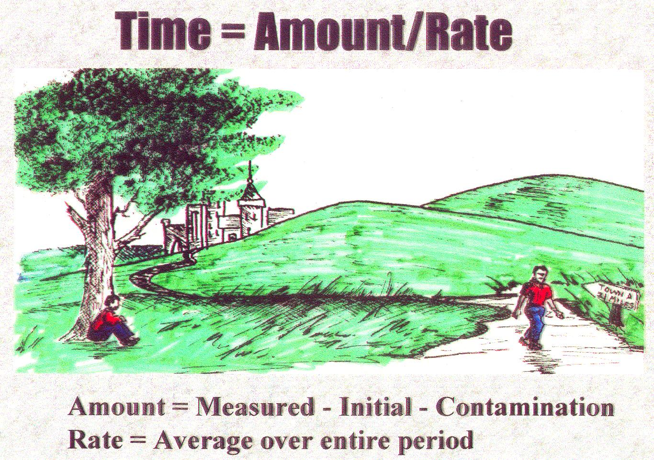
What can science prove about the Earth’s age?

Slide 13
The Vast Majority of Dating Methods Indicate a Relatively Young Earth
“For every dating method indicating billions of years of earth history there are ten methods indicating the earth is far too young for evolution to have happened.”
- Dr. Russell Humphreys
Old Age Dating
Methods
Young Age Dating
Methods

Slide 14
A few of many young Earth dating methods
Pressure remaining in oil deposits
Decay of the Earth’s magnetic field
Supernovas found vs. occurrence rate
Turbulence remaining in Saturn’s rings
Size of Mississippi river delta
Concentration of elements in ocean
World population growth
Coral reef growth
Amount of volcanic sediment
Lack of new star formation
Existence of short term comets
Amount of cosmic dust in solar system
Human fossil remains/graves
Temperature of the earth
Stalagmite growth rate
Rate of coal formation
“White hole” cosmology
Helium in the earth’s atmosphere
Polystrata fossils
Genetic code deterioration rate
Carbon-14 still left in diamonds
Oldest living plants
Size of the fossil beds
Clustered galaxies
Helium in zircon crystals
Erosion rate of the continents
Internal heat of Io
Tree ring chronology
Concentration of salt in the ocean
Moon activity/distance
Sea floor sediment depth
Cosmic dust accumulation on the earth
Mutational load of biological life
Size of the earth’s human population
Meteorites in the earth’s sediment
Cold Material in Earth’s Mantle
Polystrata fossils
Average depth of topsoil
Carbon-14 in level in organic matter
Rate of human mutational changes
Squashed radiohalos
Salt in the dead sea
Ice cap accumulation rate
Age of Niagara Falls
Sandstone intrusions
Total coal volume on earth
Purity of salt dome deposits
Existence of distant spiral galaxies

Slide 15
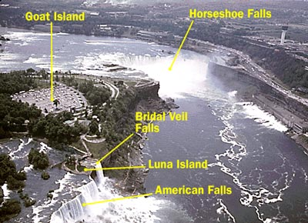
Formation of Niagara Falls
Falls eroding at a rate of 4-5 ft./yr.
Falls are 37,000 ft. from lake Ontario
Modern Erosion
Falls cannot be much older than 9000 years old
Erosion shortly after the flood would have been much faster

Slide 16
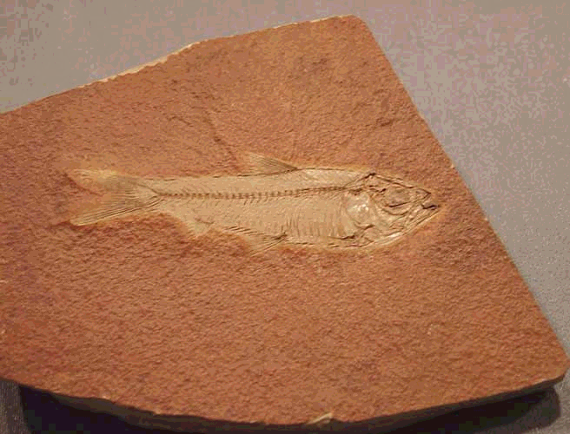
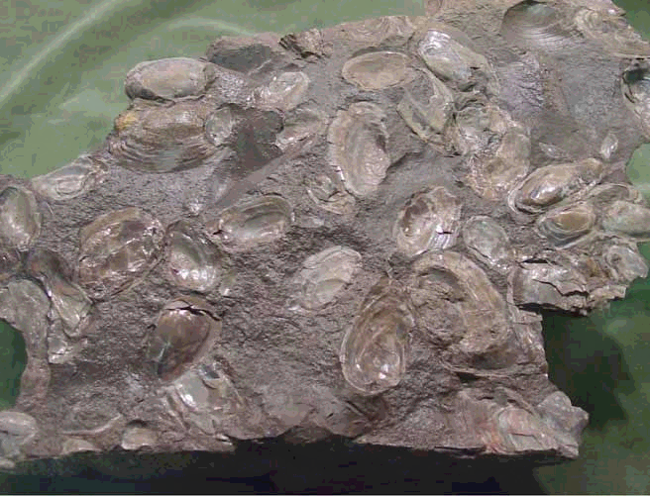
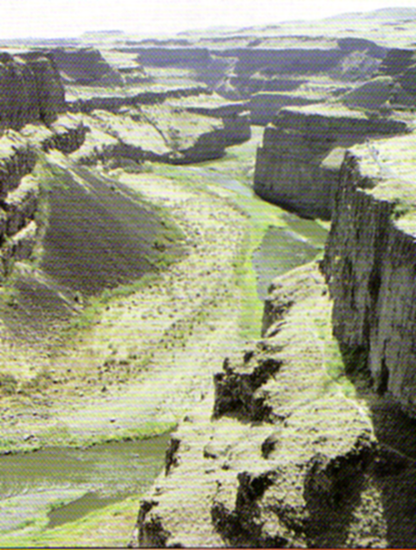
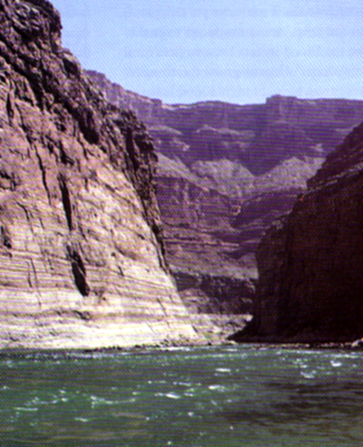
Without acknowledging the FLOOD…
…geology is misinterpreted
This flood would have caused:
  Fossils deposited worldwide
  Extensive layers of sedimentary rocks
  Massive coal and oil fields
  Widespread erosion features
  A subsequent ice age

Slide 17
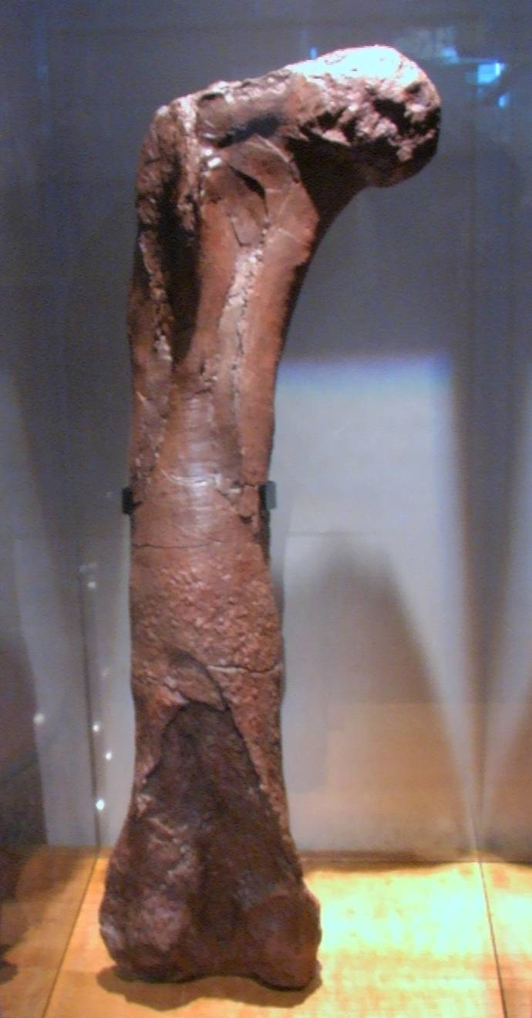
This t-Rex dinosaur bone, assumed to be 68 million years old, was found by Dr. Mary Schweitzer and was broken during removal from site.

Slide 19
Where are all the people?
History
World population has
historically doubled every
150 years
This is independent of war,
famine, disease, etc.
6…12…24…7 billion = 30 X
30 x 150 years = 4500 years

Slide 20
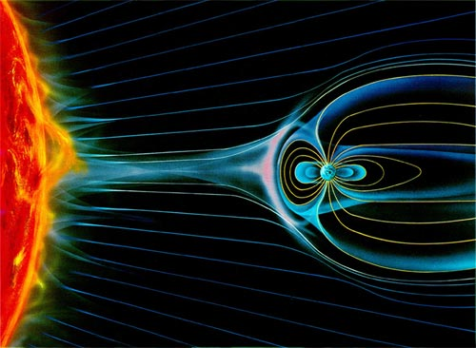

Cosmology
Strength of the Earth’s Magnetic Field
Electromagnetic field is decaying exponentially
Has decreased 15% in last 150 years
20,000 years ago –field too strong for earth to support life
10,000 from now – field too weak to support life
Field “just happens” to be exactly right strength to support life

Slide 21
Physics
Radiometric Dating
Radiometric dating supposedly “proves” that the earth is billions of years old.
  Helium is from decay processes.
  Decay starts rocks so helium trapped there.
  With time helium permeates (leaks) out.
  The older the rock…the less helium!
Where the helium is located reveals the true age of the rocks.

Slide 22
Physics

Slide 23
Chemistry
There is a lack of helium in atmosphere
Total amount = 3.5x10¹² kg
The amount left in rock crystals indicates that the decay happened approximately 6000 years ago.
Known input = 3.0x10⁸ kg/yr
Max age =
10,000 years
Helium permeates out
at a known rate
Helium forms in rock
by radioactive decay
There is way too much helium in rock crystals

Slide 24
Genetic Deterioration
“It has long been acknowledged by geneticists that if the rate of deleterious mutations approached ONE PER GENERATION, long-term genetic deterioration would be a certainty.” ¹
- Muller, H.J. 1950. Our Load of Mutations. American Journal of Human Genetics, 2:111-176.
Estimated Mutations per Human Generation¹:
Mutation Type | Mutations/generation | Nucleotide changes/generation
1. Mitochondrial mutations | <1 | <1
2. Nucleotide substitutions | 100-300 | 100-300
3. Satellite mutations | 100-300 | 100-300
4. Deletions | 2-6 (or more) | 300 - 3000
5. Duplications/insertions | 2-6 (or more) | 300 - 3000
6. Inversions/translocation | >1 | Thousands?
7. Conversions | Thousands? | Multiple Thousands?
Total/person/generation | >1000 ? | > 10,000 ?
- Dr. J. C. Sanford, 2006, Genetic Entropy & the Mystery of the Genome 3rd Ed., p. 42, FMS Publications

Slide 25
RadioCarbon Dating
Physics
1/2 of carbon disappears
every 5730 years
Modern equipment can
measure 0.001% of
modern levels (or 100,000
years)
Every atom of radioactive
carbon should be gone
within 250,000 years
Yet there are enormous amounts
of radiocarbon left

Slide 26
Why is there so much radiocarbon?
This astounding evidence for a young
earth is simply ignored!

Slide 27


Why is there so much radiocarbon?

Slide 28
Amount left in organic samples
Amount left in diamonds
Equipment detection limit

Slide 29
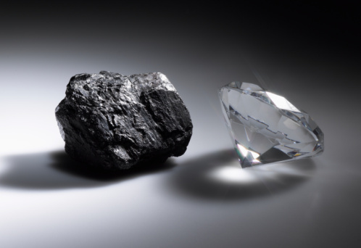

Slide 30

On one hand is the evidence for our recent creation
Fresh tissue in dinosaur bones
Carbon-14 still remaining in ancient artifacts/fossils
Rapid buildup of genetic mistake in human genome
Helium from radioactive decay still in granite layers
Rapid decay of Earth’s magnetic field
Nature of geological rock layers

Slide 31

On the other hand is the damage done by rejecting a straightforward Biblical understanding
The Bible cannot be understood to mean what it says
God is responsible for billions of years of death
Adam becomes a mythical symbol
There couldn’t have been a recent global flood
The Bible is wrong about history, geology, biology…
Why believe it about anything else?

Slide 32
The Bible Can Be Trusted
Old Age
Dating
Methods
Young Age
Dating
Methods

Slide 34
Time
& the Domino Effect

Slide 35

Creation was
Recent

Slide 36
Death because of man’s rebellion

Slide 37
Worldwide Flood was REAL

Slide 38
SIN causes DEATH

Slide 39
Bible correct about moral truth

Slide 40
Creation was
Recent

Slide 41
Death because
of man’s
rebellion

Slide 42
Worldwide Flood
REAL

Slide 43
Sin causes DEATH

Slide 44
Bible correct
about
moral truth

Slide 45
Scoffers will come in the last days saying, “…all things have continued as they were from the beginning of creation.”
…they willfully forget…
by the word of God the earth was made out of water…and the world that then existed perished, being flooded by water.
II Peter 3:3-6

